Slide 1
Image Segmentation and Tracking using a Difference of Convex Regularized Mumford-Shah Functional
Fred Park
Whittier College
UC Irvine AI/ML Seminar
November 5th, 2018

Slide 2
Collaborators
Jack Xin (UCI Math)
Yifei Lou (UT Dallas Math)
Work supported by:
ONR (grants N00014-11-1-0602)
NSF (grants DMS-1222507, DMS-1522383, and DMS-1522786)

Slide 3
Outline
Image Segmentation and Tracking
  Motivation for Processing
  Image Denoising: TV Model
  Image Segmentation: Chan Vese Model
Shape Modeling
Shape Prior Segmentation
Point Cloud Surface Reconstruction
Ongoing and Future Work

Slide 4
Outline
Intro to Image Processing
  Image Representation
  Motivation for Processing
  Image Denoising: TV Model
  Image Segmentation: Chan Vese Model
Shape Modeling
Shape Prior Segmentation
Point Cloud Surface Reconstruction
Ongoing and Future Work

Slide 5
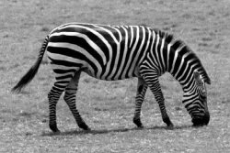
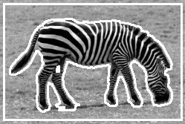
Image Segmentation
Problem: Detect Salient Regions & their Boundaries
Often: P.W. Smooth (or cartoonish) regions & sharp boundaries
Useful for object location & recognition, medical imaging (tumor detection etc.), face recognition, tracking, … and more

Slide 6
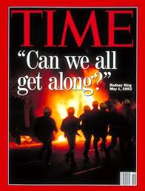
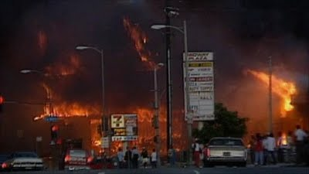
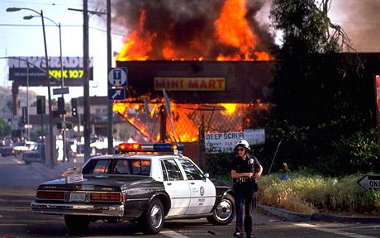
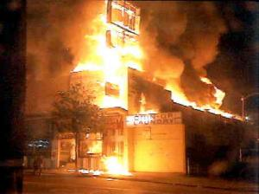
Image Segmentation: Motivation
Recall the Los Angeles Riots of 1992

Slide 7
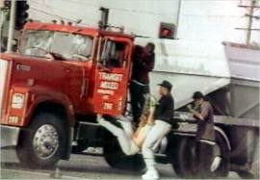
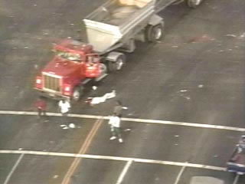
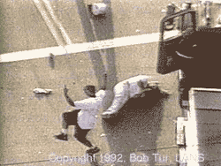
Image Segmentation: Some Motivation
High Point of Riots: Reginald Denny Beaten Mercilessly on Nat’l. TV
Public Outrage!
Perpetrators at large!

Slide 8
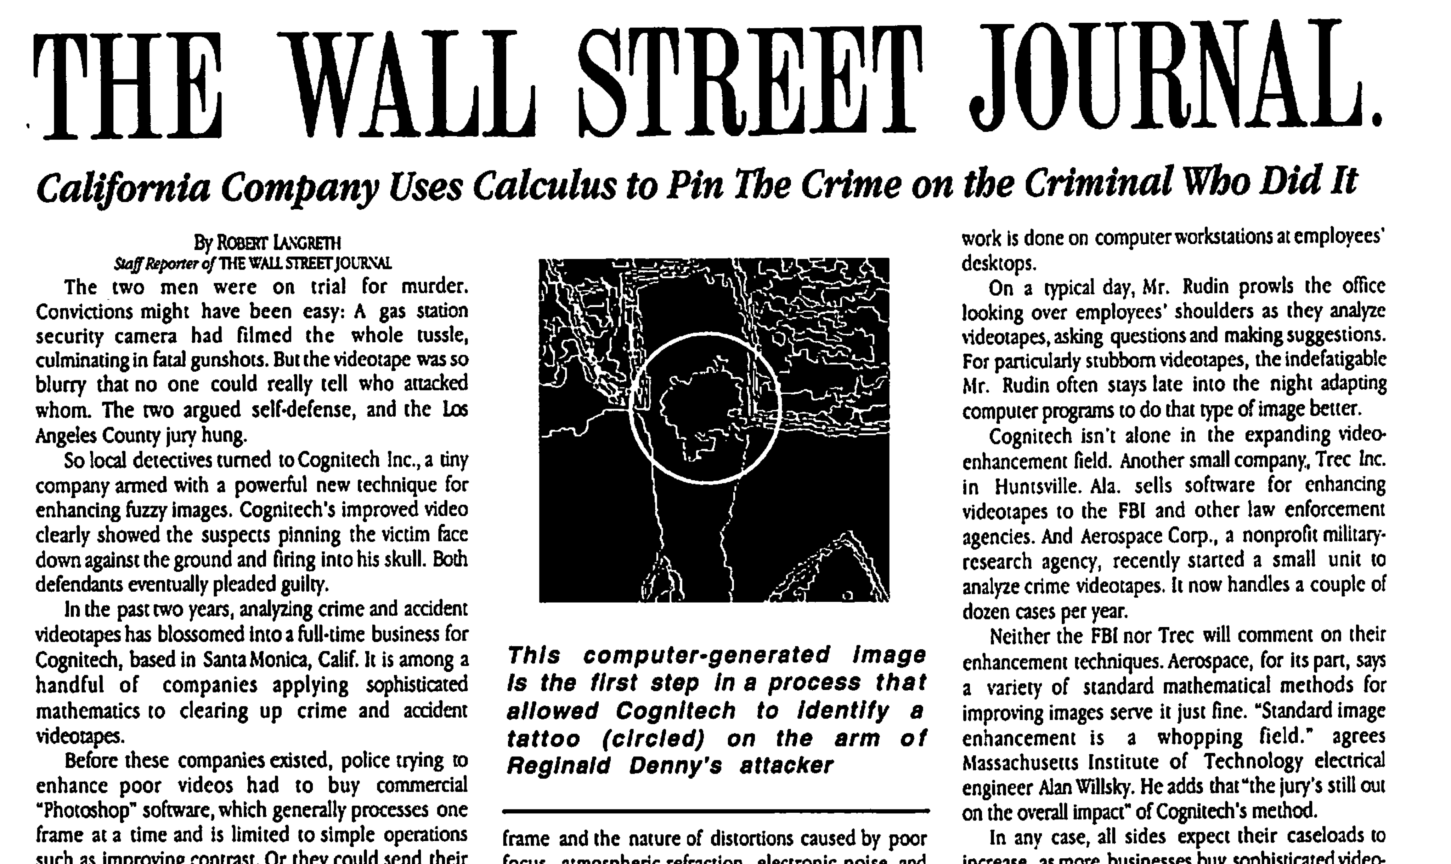
Calculus Based Image Processing Used to Enhance Footage
Cognitech and UCLA Image Processing Group Help LAPD

Slide 9

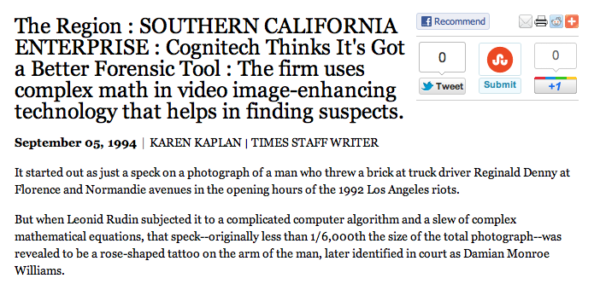
It started out as just a speck on a photograph of a man who threw a brick at truck driver Reginald Denny at Florence and Normandie avenues in the opening hours of the 1992 Los Angeles riots.
But when Leonid Rudin subjected it to a complicated computer algorithm and a slew of complex mathematical equations, that speck--originally less than 1/6,000th the size of the total photograph--was revealed to be a rose-shaped tattoo on the arm of the man, later identified in court as Damian Monroe Williams.

Slide 10
Image Processing
Crime Footage
Ã Original Crime Scene Video
Ã Tattoo Superresolution
Ã Comparison w/ Real Tatoo
Outcome:
All 3 Criminals Convicted!

Slide 11




Application: “active contour”
Initial Curve Evolutions Detected Objects

Slide 12
Basic idea in classical active contours
Curve evolution and deformation (internal forces):
Min Length(C) +Area(inside(C))
Boundary detection: what is it? What is stopping criteria for curve?
Initial Curve Evolutions Detected Objects

Slide 13




Data Fidelity Term
where
Fit > 0 Fit > 0 Fit > 0 Fit ~ 0
Minimize: (Fitting +Regularization)
Fitting not depending on gradient detects “contours without gradient”

Slide 14
Chan-Vese (CV) Model
Fitting + Regularization terms (length, area)
C = boundary of an open and bounded domain
|C| = the length of the boundary-curve C
P.W. Constant Version of Mumford Shah Model
Fit constant homogeneous regions while enforcing regularity on boundary of C
Active Contours without Edges

Slide 15
Experimental Results
Advantages
Automatically detects interior contours!
Works very well for concave objects
Robust w.r.t. noise
Detects blurred contours
The initial curve can be placed anywhere!
Allows for automatic change of topologies

Slide 16
Outline
Intro to Image Processing
  Image Representation
  Motivation for Processing
  Image Denoising: TV Model
  Image Segmentation: Chan Vese Model
Shape Modeling
Shape Prior Segmentation
Point Cloud Surface Reconstruction
Ongoing and Future Work

Slide 17
Convex Relaxed CV Model
Prev. Implement’s. of CV model use level set methods

Slide 18
Convex Relaxed CV Model
Level Set Methods:
Depend on initialization → yields non-unique segmentations
Needs re-distancing → slower convergence & computationally intensive
Level set formulation is non-convex (Heaviside function → binary)
New implement’s of MS/CV models use convex relaxation techniques

Slide 19
Convex Relaxed CV Model
Relaxed 2 phase Mumford-Shah (Chan-Vese) model:
Segmented region Σ via thresholding:
For fixed c₁ and c₂ model is convex
Robust to initialization
Fast minimization techniques

Slide 20
Convex Relaxed CV Model
Caveats of CV model (L₂ TV norm):
Isotropic TV norm (L₂ TV) regularizes in all gradient directions
Gradient distributions not equal in all directions
May not capture appropriate boundaries of certain objects
Anisotropic TV norm (L₁ TV) is more directional
Boils down to what norm has most sparsity on the gradient of u

Slide 21
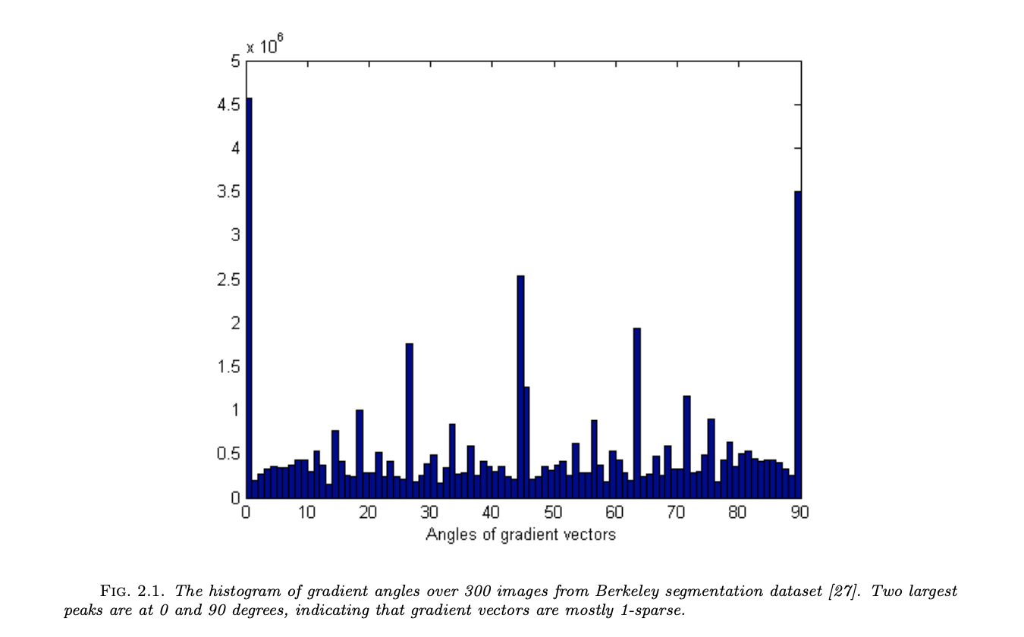
Convex Relaxed CV Model
Most gradient angles are at 0 and 90 degrees!

Slide 22
Convex Relaxed CV Model
Partition boundaries in MS & Potts model rep’d by L₀ Norm:
Gradient distribn’s mostly vertical and horizontal in natural images.
L₁-αL₂ TV norm is better approx’n to L₀ via level lines than L₂ TV.
α chosen based on gradient distrib’s
L₁ - 0.5L₂ closer to L₀ than:
L₁, L₂, and L₁ - L₂
Level lines plot

Slide 23
Proposed Model
Difference of Anisotropic and Isotropic TV CV model
Convex Relaxed CV model is now Non-Convex!
How to minimize it now?

Slide 24
Proposed Model
Difference of Anisotropic and Isotropic TV CV model
Can be written as a difference of convex!
(c is parameter for strong convexity)

Slide 25
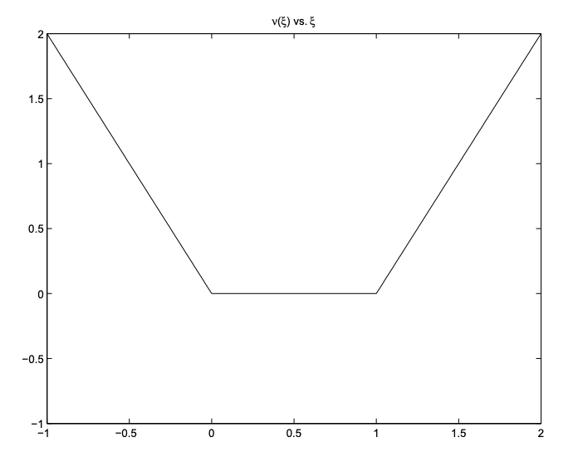
DCA Algorithm
DCA algorithm → linearization of the non-convex terms and then iterating
linearized

Slide 26
Splitting
splitting
Split data fidelity and exact penalty terms
Equivalent to minimizing sub-problems:

Slide 27
Solving Sub-Problems

Slide 28
Primal Dual Hybrid Gradient
Primal problem:
Becomes the primal-dual problem:
How to solve the primal-dual problem?
Fast method via the Primal Dual Hybrid Gradient Method (PDHG)
Zhu and Chan ‘08, Chambolle and Pock ‘10, Chambolle et al. ‘18

Slide 29
Primal Dual Hybrid Gradient
Key idea:

Slide 30
Primal Dual Hybrid Gradient
Key idea:

Slide 31
Primal Dual Hybrid Gradient
Key idea:

Slide 32
Primal Dual Hybrid Gradient
Final Algorithm

Slide 33
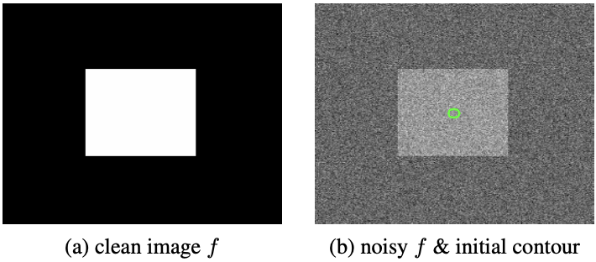
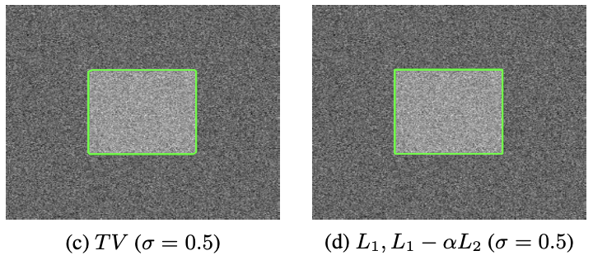
Numerical Results: Proposed
Proposed more accurately captures the boundary of the square

Slide 34
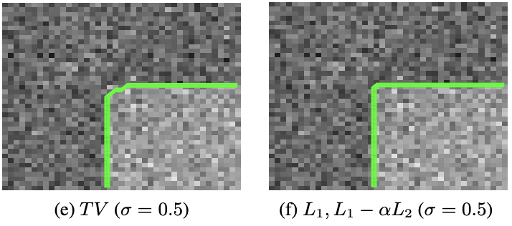
Numerical Results: Zoomed
Proposed more accurately captures the boundary of the square

Slide 35
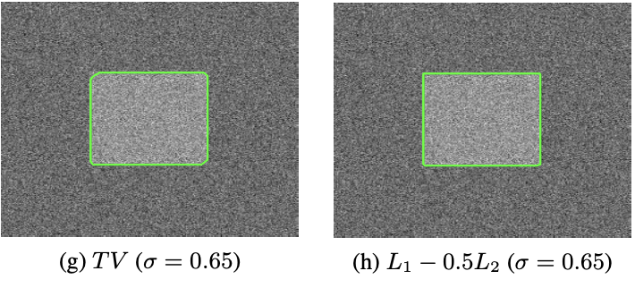
Numerical Results: More Noise
Proposed more accurately captures the boundary of the square

Slide 36
Numerical Results L₂ TV
Regularize gradients in all directions
Chair Image
Chair leg captured incorrectly.
Increasing regularization loses features.
Increasing Regularization
Results in Loss of Features
Figure 1. Chair Image

Slide 37
Numerical Results: Proposed
L₂ TV
L₁-αL₂ TV
Proposed accurately captures chair leg without loss of features

Slide 38
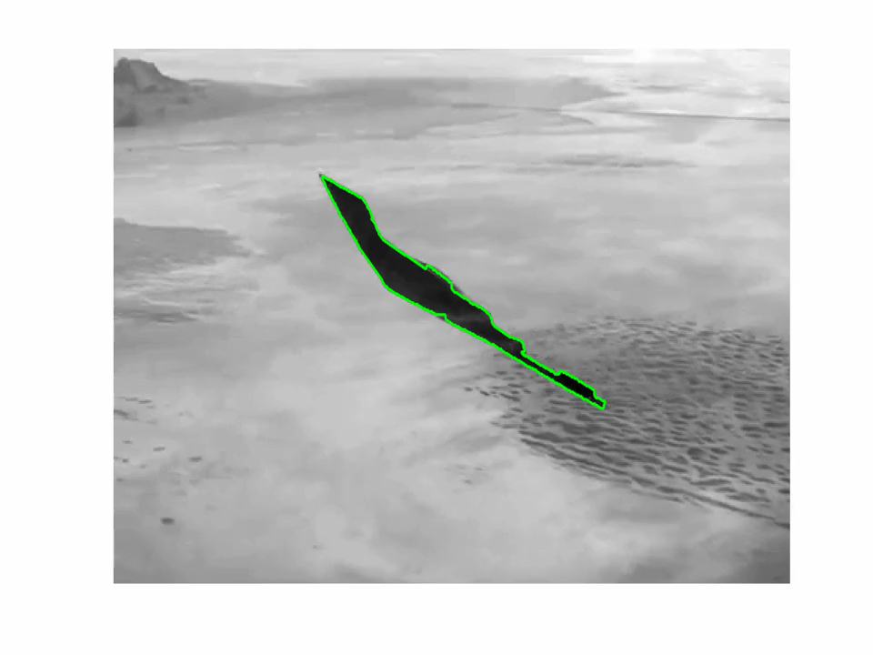
Proposed: Tracking Example

Slide 39
Ongoing and Future Work
Convergence proof of the DCA algorithm for proposed model
Other ways of achieving/exploiting directional sparsity
Shape Prior Segmentation: Modeling both occluders and shapes
Neural Network → semantic segmentation. Interplay between a trained model and a mathematical one. Not a 2 step approach but a synergistic one.
Using CNN’s for applications to spatially varying blind deconvolution.
Primal Dual methods for Neural Network Optimization
Convex relaxation techniques for NN’s. Some work done on quantizing weights. Xi et al. ‘18

Slide 40
Cliques Invariant Signature
r₃
r₂
Motivatation:
Bending Invariant Signatures
Elad and Kimmel 03’
r₁
r_{n}
Intervertex Distances:
r_{n-1}
r_{i}: pts. lying on reference shape
p_{i}: pts. lying on some evolving contour
Incorporation into:
Geodesic Active Contours (Snakes)
Polygonal Implementation of the P.W. Constant MS Model

Slide 41
Shape Prior Segmentation
Why are Shape Priors Needed?
Example of MS Segmentation Without Shape!
Difficult Cases: Clutter, Regions w/ non-uniform intensities, Occluded Objects
Prior Must be compatible with Segmentation Models i.e. both can be minimized

Slide 42
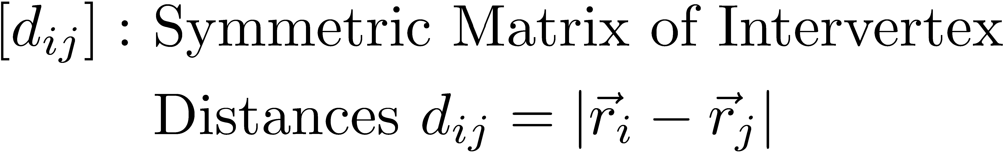
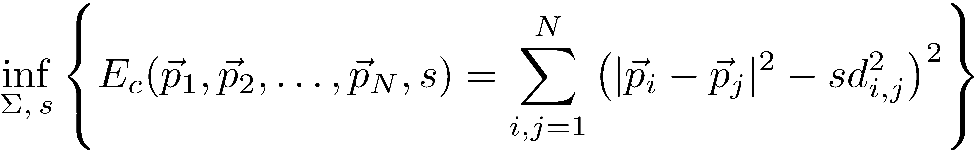
Cliques Shape Matching Energy
Shape Matching Energy:
‘s’: scale parameter to be min’d over as well
Invariance to Rigid Motion
Scale Invariance

Slide 43
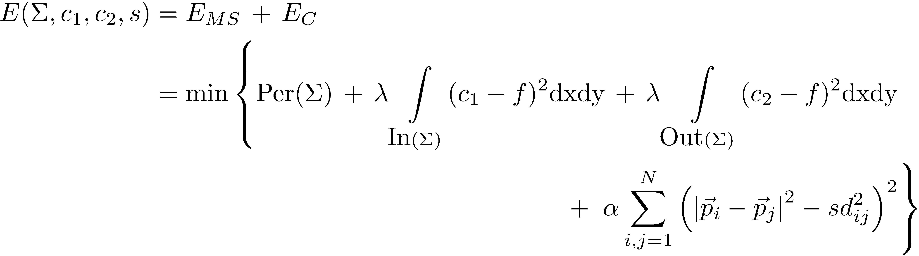
Proposed Model
®: shape strength
§: Evolving Polygonal Curve
Polygonal CV Model + Shape!
Best approx of ‘f’ in L² sense taking 2 values c₁ and c₂
While Enforcing § matches reference shape

Slide 44
Variations of the Perimeter Term
Perimeter Term:
Variations of Perim. Term:
ODE system describing time evolution of vertices:

Slide 45
Variations of Data Fidelity Term
In gradient descent, the fidelity term contributes the velocity:
ODE system describing time evolution of vertices:

Slide 46
Variations of shape prior and scale parameter
Variations wrt Shape Prior Term:
In gradient descent, shape term contributes the velocity:
Optimization wrt scale parameter ‘s’ yields simple cond’n:

Slide 47
Update of constants c₁ and c₂
Variations wrt c₁ and c₂ in CV NRG yield:
Vector Form of Green’s Theorem:
Procedure to get integral quant’s:
|§| can also be found simply by using formula with f ´ 1
Point is: Can obtain area integrals via boundary integrals of polygonal curve accurately!

Slide 48
Final Proposed Algorithm
Complete Gradient Descent Curve Evolution ODE:
Explicit Gradient Descent Time Marching Scheme:
Algorithm:
Calculate Shape Signature for Ref. shape
Initialize Polygonal Curve
Update constants c₁ and c₂ via explicit formulas
Calculate Scale Match by explicit formula
Evolve curve by above time marching scheme
Repeat: Steps 3 to 5 until reach fixed contour (steady state)

Slide 49
Shape Prior Segmentation Example
Learned Ref Shape
Image to be Segmented
Prior Juxt’d on Image
Final Seg’d. Image!
Increasing
shape strength
® = 0.1
® = 0.5
® = 1.0
Final Segmented Image!

Slide 50
Shape Prior Segmentation
With Shape
Without Shape

Slide 51
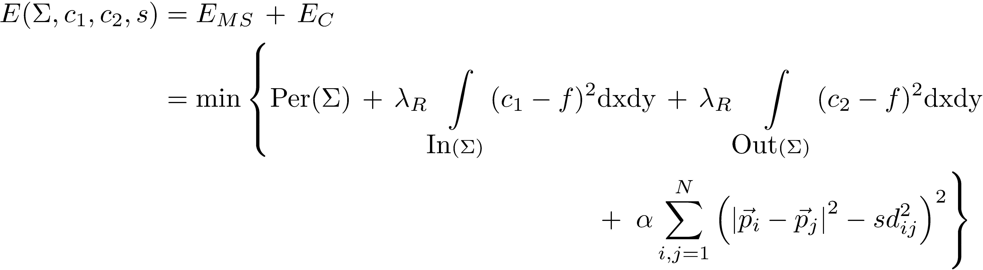
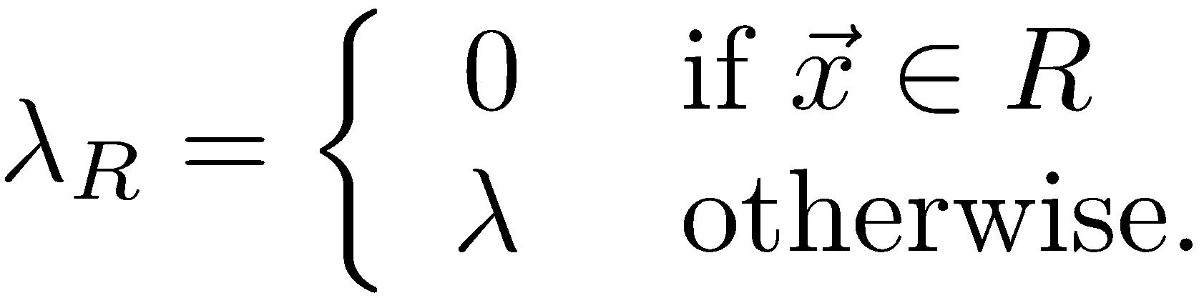
Disocclusion
Occluded Region: R
R: Occluded Region
Don’t fit data in R

Slide 52
Disocclusion Example
144x144
500x500
Scale difference
Learned reference shape
Occluded Image
Initial contour
Final evolved
contour
Disoccluded contour
w/ true image

Slide 53
Shape Prior Segmentation: Very Difficult Case
Initial curve
With Prior
No Prior!
Fuselage matches tarmac.
2 completely different intensities in plane
Very difficult segmentation!
prior

Slide 54
Ongoing and Future Work
Convergence proof of the DCA algorithm for proposed model
Other ways of achieving/exploiting directional sparsity
Shape Prior Segmentation: Modeling both occluders and shapes
Neural Network → semantic segmentation. Interplay between a trained model and a mathematical one. Not a 2 step approach but a synergistic one.
Using CNN’s for applications to spatially varying blind deconvolution.
Primal Dual methods for Neural Network Optimization
Convex relaxation techniques for NN’s. Some work done on quantizing weights. Xi et al. ‘18

Slide 55
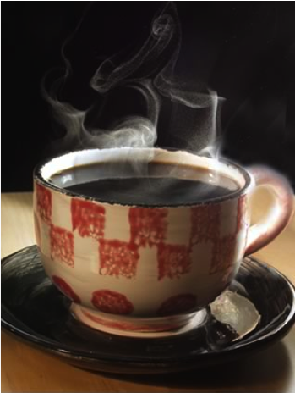
Thank You for Your Attention!

Slide 56
Thank You for Your Attention!

Slide 57
Basic idea in classical active contours
Curve evolution and deformation (internal forces):
Min Length(C)+Area(inside(C))
Boundary detection: stopping edge-function (external forces)
Example:
Snake model (Kass, Witkin, Terzopoulos ‘88)
Geodesic model (Caselles, Kimmel, Sapiro ‘95)

Slide 58
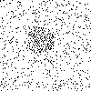

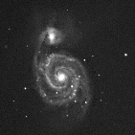
Limitations
- detects only objects with sharp edges defined by gradients
- the curve can pass through the edge
- smoothing may miss edges in presence of noise
- not all can handle automatic change of topology
Examples

Slide 59
Mumford-Shah Image Segmentation (‘89)
K: finite union of curves (set of edges)
u: -piecewise smooth approx. to f
-smooth in each connected compt. of ΩnK
-jumps allowed across curves in K
Early variational model for image segmentation
u fits given image f by p.wise smooth regions w/ sharp edge boundaries K
Non-Convex Model!
Still many approaches to minimize the energy by approximation cf. level set methods, global convexification methods, etc.
Full Model is “Overkill” for most applications

Slide 60
Mumford-Shah Segmentation Examples

Slide 61
Application: Active Contours
Initial Curve Evolutions Detected Objects

Slide 62
Basic idea in classical active contours
Curve evolution and deformation (internal forces):
Min Length(C)+Area(inside(C))
Boundary detection: stopping edge-function (external forces)
Example:
Snake model (Kass, Witkin, Terzopoulos ‘88)
Geodesic model (Caselles, Kimmel, Sapiro ‘95)

