Slide 1
Mentoring Undergraduates in Applied Mathematics and Computer Science Research
Fred Park
Whittier College
AMS Sectional Meeting, UC Riverside
November 9th, 2019

Slide 2
My Background
Undergrad in Research at UCLA with 3 students
Team lead at UCI Interdisciplinary Computational Applied Math (iCAMP) REU for 2 years
Undergraduate Research at various levels at Whittier College
e.g. fellowships, senior seminar, or otherwise

Slide 3
Problem Formulation
Coming up with an interesting problem is the first step
Main thing I found
Problem should be :
interesting to both the mentee and mentor
problem should challenge both
problem should be engaging to both

Slide 4
Problem Formulation
Problem should be :
interesting to both the mentee and mentor
problem should challenge both
problem should be engaging to both
example 1: student interested in illusory contours → match
example 2: student interested in modeling drums in music.
me = interested in ML to mine patterns in music → no match.
Don’t be afraid to suggest a different direction.
Goal is to find a project that interests the both of you above all!

Slide 5
Problem Formulation
keep a list of potential undergrad research problems either of your own curiosity or from your research.
flexibility is usually key as research tends to different directions quickly.
I know I’m just stating the obvious! :)

Slide 6
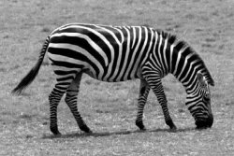
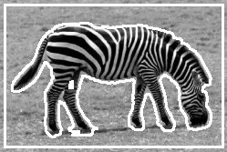
Case study 1: Image Segmentation
What is Segmentation:
Computer Vision Task: find the boundaries of salient regions in an image

Slide 7
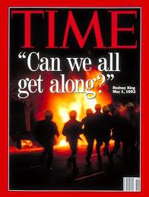
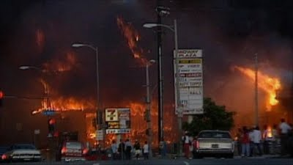
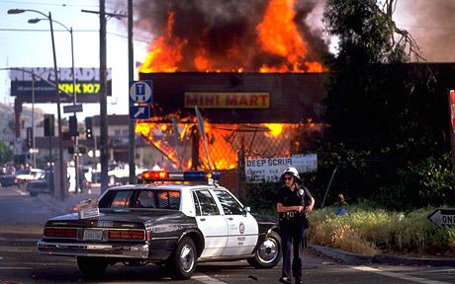
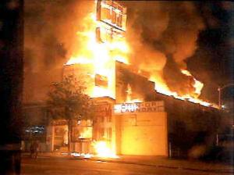
Image Segmentation: Motivation
Recall the Los Angeles Riots of 1992

Slide 8
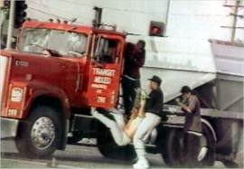
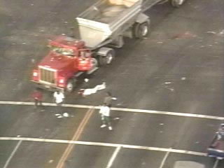
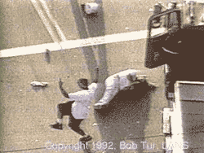
Image Segmentation: Some Motivation
High Point of Riots: Reginald Denny Beaten Mercilessly on Nat’l. TV
Public Outrage!
Perpetrators at large!

Slide 9
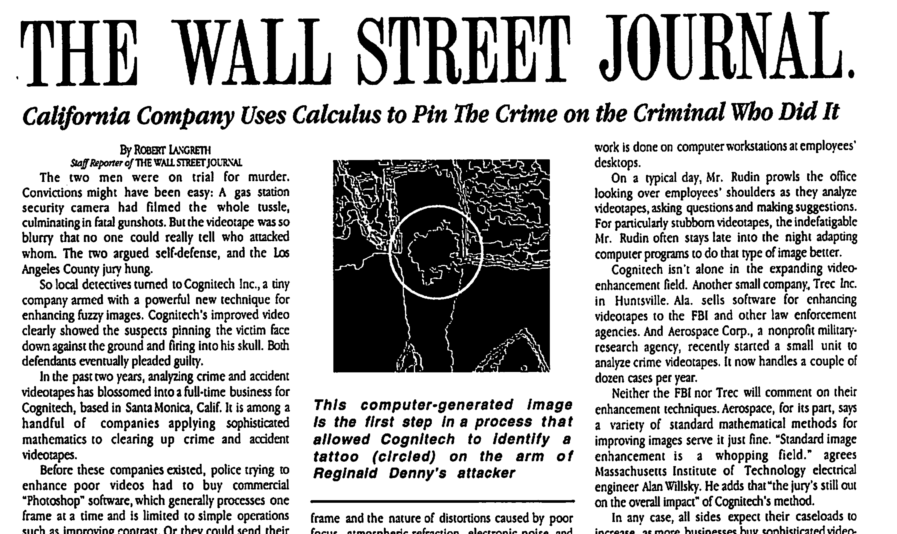
Calculus Based Image Processing Used to Enhance Footage
Cognitech and UCLA Image Processing Group Help LAPD

Slide 10

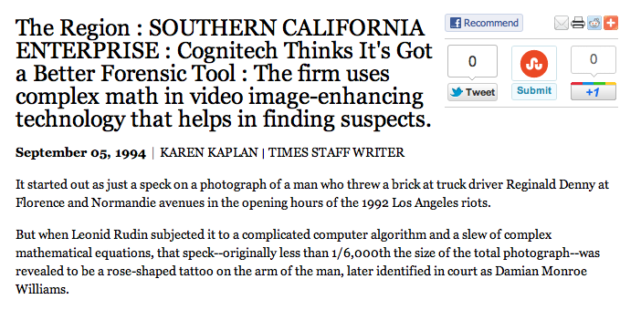
It started out as just a speck on a photograph of a man who threw a brick at truck driver Reginald Denny at Florence and Normandie avenues in the opening hours of the 1992 Los Angeles riots.
But when Leonid Rudin subjected it to a complicated computer algorithm and a slew of complex mathematical equations, that speck--originally less than 1/6,000th the size of the total photograph--was revealed to be a rose-shaped tattoo on the arm of the man, later identified in court as Damian Monroe Williams.

Slide 11
Image Processing
Crime Footage
Ã Original Crime Scene Video
Ã Tattoo Superresolution
Ã Comparison w/ Real Tatoo
Outcome:
All 3 Criminals Convicted!

Slide 12
Case study 1: Image Segmentation
my prior work --> image segmentation and shape priors
Prior UCI REU → lots of shape modeling
Shape Priors → shape info to aid in tough segmentation problems

Slide 13
Shape Prior Segmentation
With Shape
Without Shape

Slide 14


Case study 1: Image Segmentation
Common interest with student → illusory contours
upside down triangle
bright disk

Slide 15


Case study 1: Image Segmentation
Common interest with student → illusory contours
cash money sign
pacman and square

Slide 16
Case study 1: Image Segmentation
common interest → illusory contours
Goal:
create model for Shape Prior Segmentation & Illusory Contour Capture!
My previous work on shape prior segmentation
does not work on Illusory Contour Capture
Model would be Geodesic active contours + shape

Slide 17




Application: Active Contours
Initial Curve Evolutions Detected Objects
What intrinsic quality of curve can minimize to make it move inward??

Slide 18
Case study 1: Image Segmentation
Map out the project
step by step with hurdles
hurdle 1: Software considerations
Use high level scripting language in initial phase of research
e.g. Matlab, Python, R, etc.
Tutorials online
If new student → work on a mini project
e.g. loading an image (selfie) and doing basic manipulation
Then build up. Smaller steps add up faster to progress than a big one bc less likely to get stuck

Slide 19
Case study 1: Image Segmentation
hurdle 2: code parametric curve and get it to move inward
wait. Must minimize:
Involves the Calculus of Variations!!

Slide 20
Case study 1: Image Segmentation
hurdle 2: code parametric curve and get it to move inward
wait. Must minimize:
Involves the Calculus of Variations!!
Solution: 1-2 weeks of reading Peter Olver’s notes on this
& calculating the Gateaux Derivative of F(C)
Get functional gradient of F(C)
Gradient Descent to minimize F(C)
Curve moves inward to min arc length

Slide 21
Case study 1: Image Segmentation
hurdle 3: how to stop the curve?

Slide 22
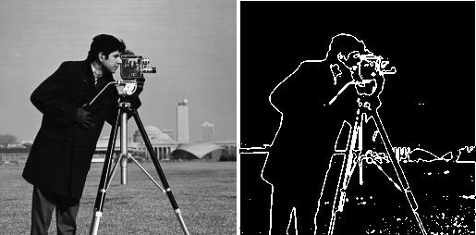
Case study 1: Image Segmentation
hurdle 3: how to stop the curve?
edge detector!
g ~ 0 on edges
g ~ 1 in flatter regions
Boundary detection: stopping edge-function (external forces)
Example:

Slide 23
Case study 1: Image Segmentation
hurdle 4: Put it together → GAC Model
g: edge detector
NRG is 0 at edges → curve doesn’t move
point is, we progressively build up
Geodesic model (Caselles, Kimmel, Sapiro ‘95)

Slide 24
Case study 1: Image Segmentation
hurdle 5: Put it together → GAC Model + Shape
Move a curve that stops at edges in image
while enforcing shape
Householder and Park 2019

Slide 25
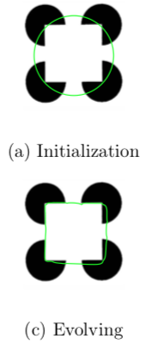
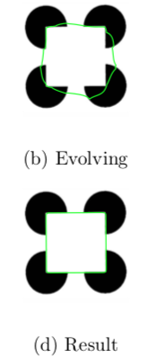
Case study 1: Image Segmentation
Householder and Park 2019

Slide 26
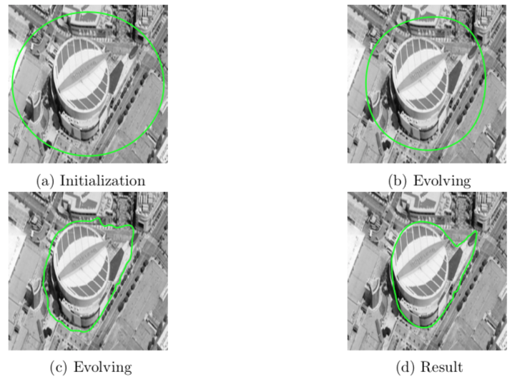
Case study 1: Image Segmentation

Slide 27
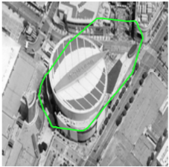
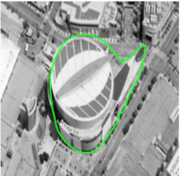
Case study 1: Image Segmentation
without shape
with shape

Slide 28
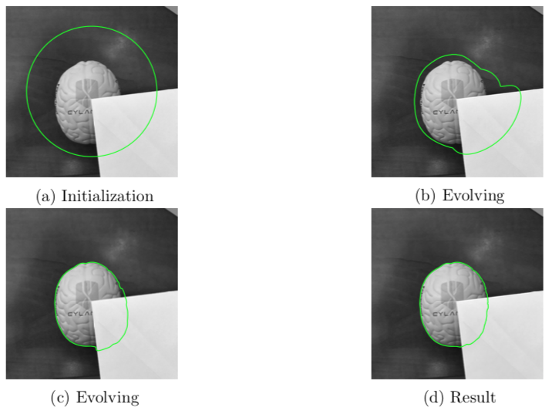
Case study 1: Image Segmentation

Slide 29
Case study 1: Image Segmentation
Important Discussion with the Student:
where does model work. where it doesn’t → model limitations
advantages over other methods
no method is a be all end all
all have advantages and disadvantages regardless of what author says (for the most part)
Undergrads really need to see this point!

Slide 30
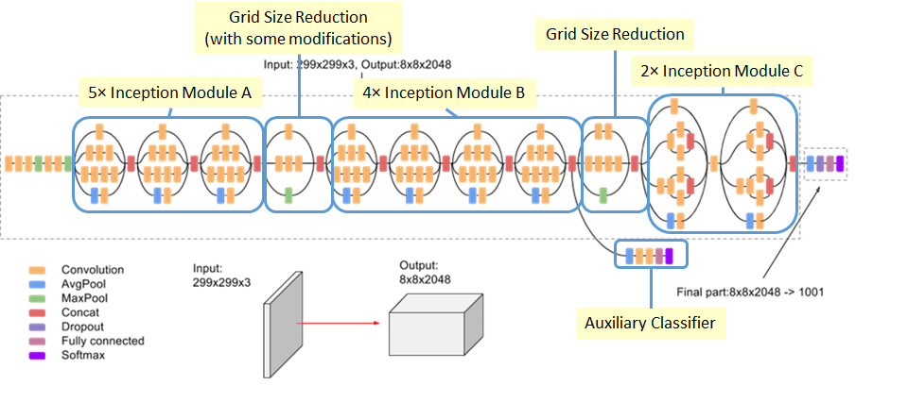
Case study II: Deep Learning
Motivate by interest
Student was interested in Deep Learning Architectures
e.g. resnets, inception, wide-resnets

Slide 31
Case study II: Deep Learning
Motivate by interest
Student was interested in Deep Learning Architectures
I was doing work on sparsity promoting norms in computer vision
→ try sparsity promoting regularizers in Deep Networks

Slide 32
Case study II: Deep Learning
Motivate by interest
Student was interested in Deep Learning Architectures
I was doing work on sparsity promoting norms in computer vision
try sparsity promoting regularizers in Deep Networks
Instead of creating new network, systematically prune existing ones
Compressed networks have huge advantages!

Slide 33
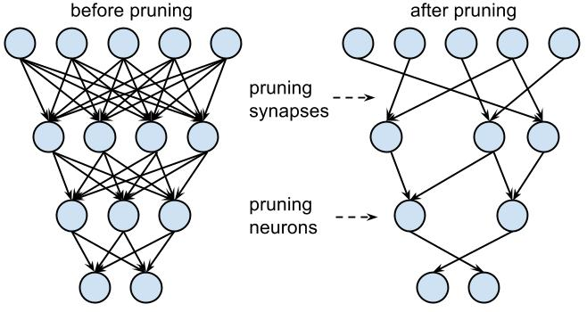
Case study II: Deep Learning
Example of a compressed network via pruning

Slide 34
Case study II: Deep Learning
Project: sparse neural networks
hurdle 1:
ML research bottleneck = computing power
Cannot do deep learning without GPU acceleration!
(GPU = graphics processing unit)
GPUs are expensive!
Cloud based solutions are even more so!
Solution??

Slide 35
Case study II: Deep Learning
option 1: hardware
nvidia: GPU research grants
internal faculty research and development grants
fellowship funding
external research grant funding
option 2: cloud computing
Google: cloud computing research grants. $5k in credits is easy to obtain and fast
AWS: cloud comp. grants. More involved but bigger awards. $15k
We got both → $20k cloud computing credits

Slide 36
Case study II: Deep Learning
One tip for Cloud Computing Grants:
Apply for grants for cloud computing credits with google or AWS
Tie undergrad research into your own research. Makes proposal stronger than if only undergrad research.
For projects:
extension of previous work
tweak of previous work
new direction of previous work
something new altogether that interests the both of you

Slide 37
Case study II: Deep Learning
Hurdle 2: Coding.
Use Pytorch (facebook AI)
Tensorflow/Keras (Google)
or create a neural net from scratch in matlab or python (no GPU)
Can also use Scikitlearn for python (no GPU)
Hurdle 2: testing models
Use standard net e.g LeNet5 on standard dataset
e.g. MNIST handwritten digits
LeNet5 trainable on most laptops.
Other sets like CIFAR 10/100, ImageNet require GPU acceleration.

Slide 38
Case study II: Deep Learning
Steep Learning curve: software, gpu, cloud computing etc.
Use github to share code.
block off multi-hour time slots to sit down and code and run training of models with your student.
the importance of coding and figuring things out together in a team environment with ML cannot be stressed enough.

Slide 39
Case study II: Deep Learning
Get standard results on network
add regularization e.g. L1, L2, L1-L2 etc. and see what happens.
Only regularize certain layers. See what happens.
vary the regularization parameter
check sparsity and accuracy
try it on groups/neurons for conv nets.
show effectiveness
again, no one method does it all
advantages and disadvantages in detail

Slide 40
Case study II: Deep Learning
Mathematical:
can prove anything?
convergence?
any links to other papers?
can prove results on a smaller network even if results may or may not hold for larger one
disseminate:
Conference:
undergrad SCURR, College Ugrad Conferences
ML/AI/IP conferences: ICIP, CVPR, etc.
Journal:
SIAM SIURO
Institutional undergrad research journals

Slide 41

Thank You for Your Attention!

Slide 42
Application: “active contour”
Initial Curve Evolutions Detected Objects

Slide 43
Basic idea in classical active contours
Curve evolution and deformation (internal forces):
Min Length(C) +Area(inside(C))
Boundary detection: what is it? What is stopping criteria for curve?
Initial Curve Evolutions Detected Objects

Slide 44




Data Fidelity Term
where
Fit > 0 Fit > 0 Fit > 0 Fit ~ 0
Minimize: (Fitting +Regularization)
Fitting not depending on gradient detects “contours without gradient”

Slide 45
Chan-Vese (CV) Model
Fitting + Regularization terms (length, area)
C = boundary of an open and bounded domain
|C| = the length of the boundary-curve C
P.W. Constant Version of Mumford Shah Model
Fit constant homogeneous regions while enforcing regularity on boundary of C
Active Contours without Edges

Slide 46
Experimental Results
Advantages
Automatically detects interior contours!
Works very well for concave objects
Robust w.r.t. noise
Detects blurred contours
The initial curve can be placed anywhere!
Allows for automatic change of topologies

Slide 47
Convex Relaxed CV Model
Partition boundaries in MS & Potts model rep’d by L₀ Norm:
Gradient distribn’s mostly vertical and horizontal in natural images.
L₁-αL₂ TV norm is better approx’n to L₀ via level lines than L₂ TV.
α chosen based on gradient distrib’s
L₁ - 0.5L₂ closer to L₀ than:
L₁, L₂, and L₁ - L₂
Level lines plot

Slide 48
Shape Prior Segmentation
Why are Shape Priors Needed?
Example of MS Segmentation Without Shape!
Difficult Cases: Clutter, Regions w/ non-uniform intensities, Occluded Objects
Prior Must be compatible with Segmentation Models i.e. both can be minimized

Slide 49
Cliques Invariant Signature
r₃
r₂
Motivatation:
Bending Invariant Signatures
Elad and Kimmel 03’
r₁
r_{n}
Intervertex Distances:
r_{n-1}
r_{i}: pts. lying on reference shape
p_{i}: pts. lying on some evolving contour
Incorporation into:
Geodesic Active Contours (Snakes)
Polygonal Implementation of the P.W. Constant MS Model

Slide 50
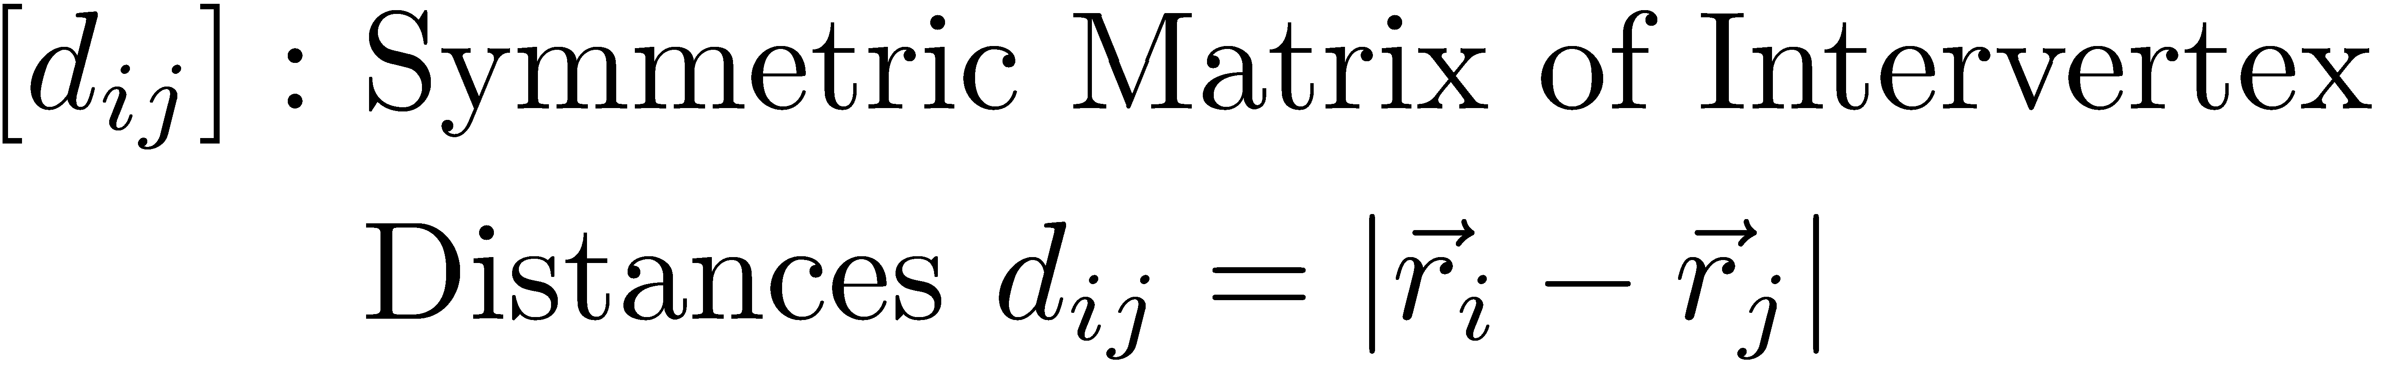
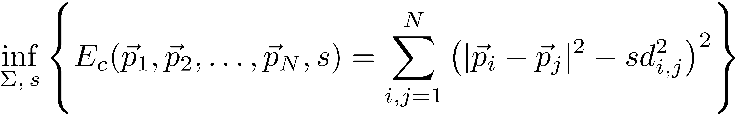
Cliques Shape Matching Energy
Shape Matching Energy:
‘s’: scale parameter to be min’d over as well
Invariance to Rigid Motion
Scale Invariance

Slide 51
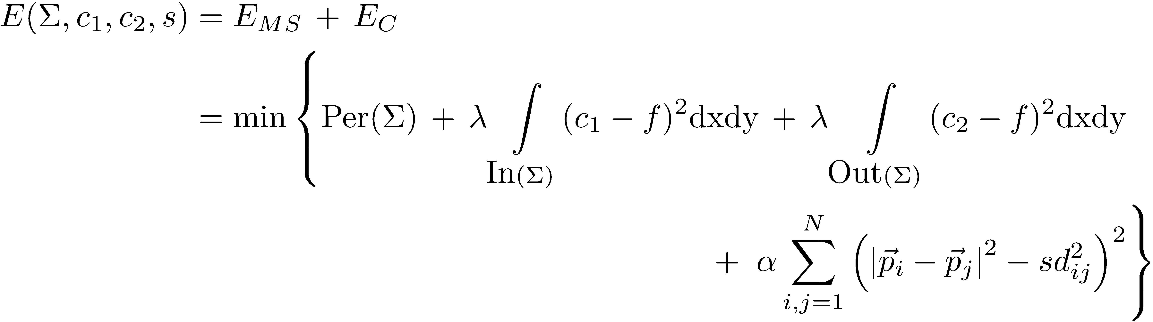
Proposed Model
®: shape strength
§: Evolving Polygonal Curve
Polygonal CV Model + Shape!
Best approx of ‘f’ in L² sense taking 2 values c₁ and c₂
While Enforcing § matches reference shape

Slide 52
Shape Prior Segmentation
With Shape
Without Shape

Slide 53
Shape Prior Segmentation Example
Learned Ref Shape
Image to be Segmented
Prior Juxt’d on Image
Final Seg’d. Image!
Increasing
shape strength
® = 0.1
® = 0.5
® = 1.0
Final Segmented Image!

Slide 54
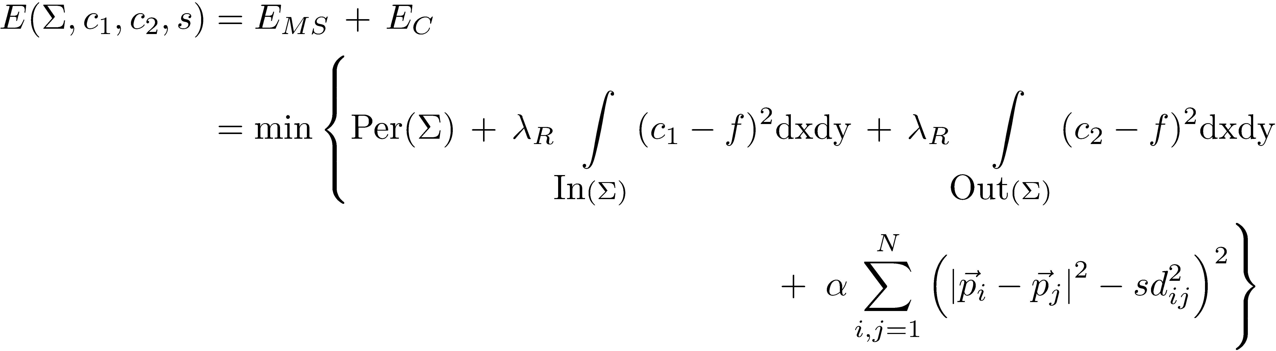
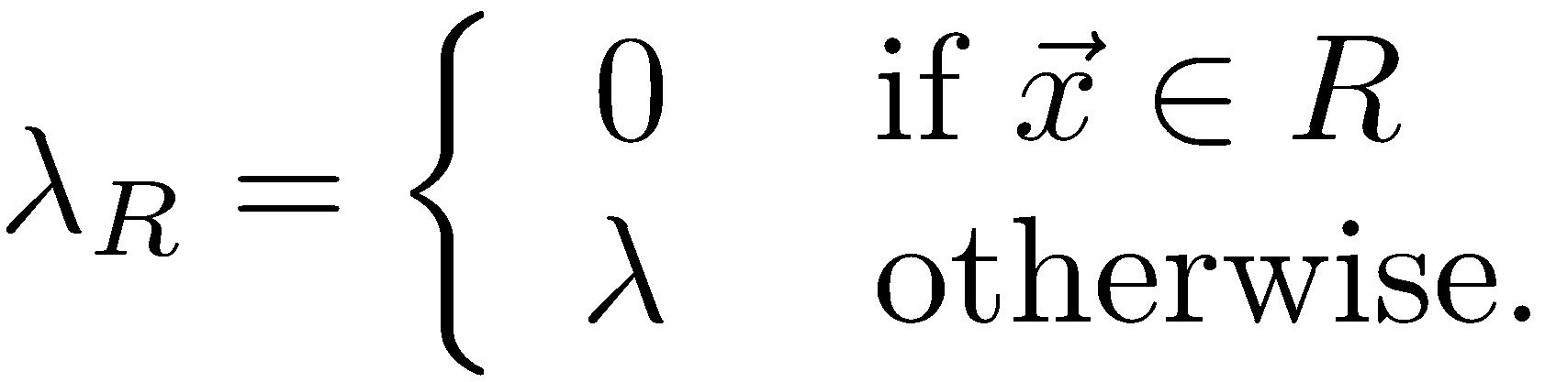
Disocclusion
Occluded Region: R
R: Occluded Region
Don’t fit data in R

Slide 55
Disocclusion Example
144x144
500x500
Scale difference
Learned reference shape
Occluded Image
Initial contour
Final evolved
contour
Disoccluded contour
w/ true image

Slide 56
Shape Prior Segmentation: Very Difficult Case
Initial curve
With Prior
No Prior!
Fuselage matches tarmac.
2 completely different intensities in plane
Very difficult segmentation!
prior

Slide 57
Ongoing and Future Work
Convergence proof of the DCA algorithm for proposed model
Other ways of achieving/exploiting directional sparsity
Shape Prior Segmentation: Modeling both occluders and shapes
Neural Network → semantic segmentation. Interplay between a trained model and a mathematical one. Not a 2 step approach but a synergistic one.
Using CNN’s for applications to spatially varying blind deconvolution.
Stochastic Primal Dual methods for Neural Network Optimization
Convex relaxation techniques for NN’s. Some work done on quantizing weights. Xin et al. ‘18

Slide 58
Thank You for Your Attention!

